Slide 1
Decoding Sarcopenic Obesity in Type 2 Diabetes through Body Composition Analysis
Here is where your presentation begins

Slide 2
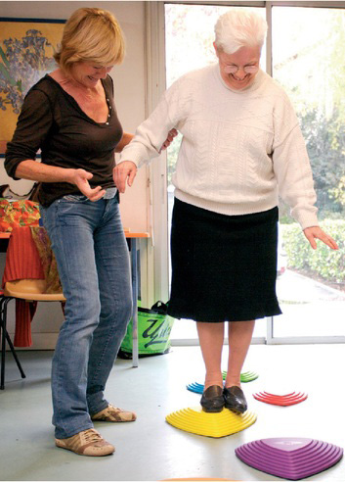
01
Sarcopenic Obesity Prevalence
Notes:
Sarcopenia and obesity frequently coexist in Type 2 Diabetes (T2D).
Body composition analysis (BCA) enables early detection of muscle–fat imbalance.
Understanding these interactions helps improve diabetic management and outcomes.

Slide 3
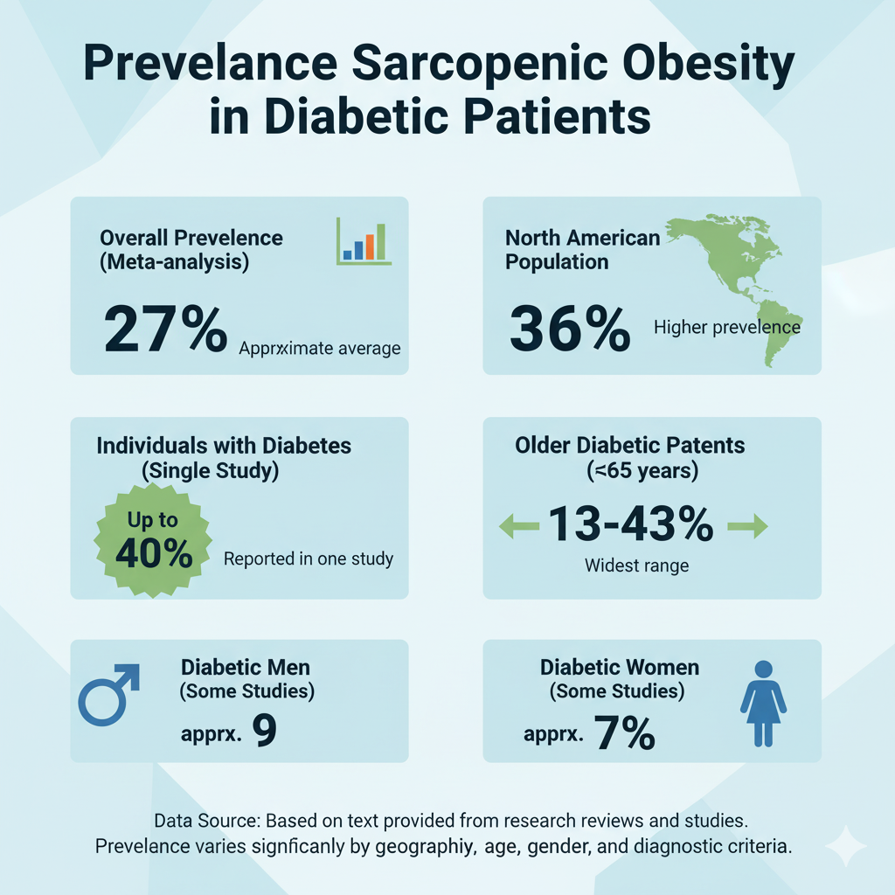
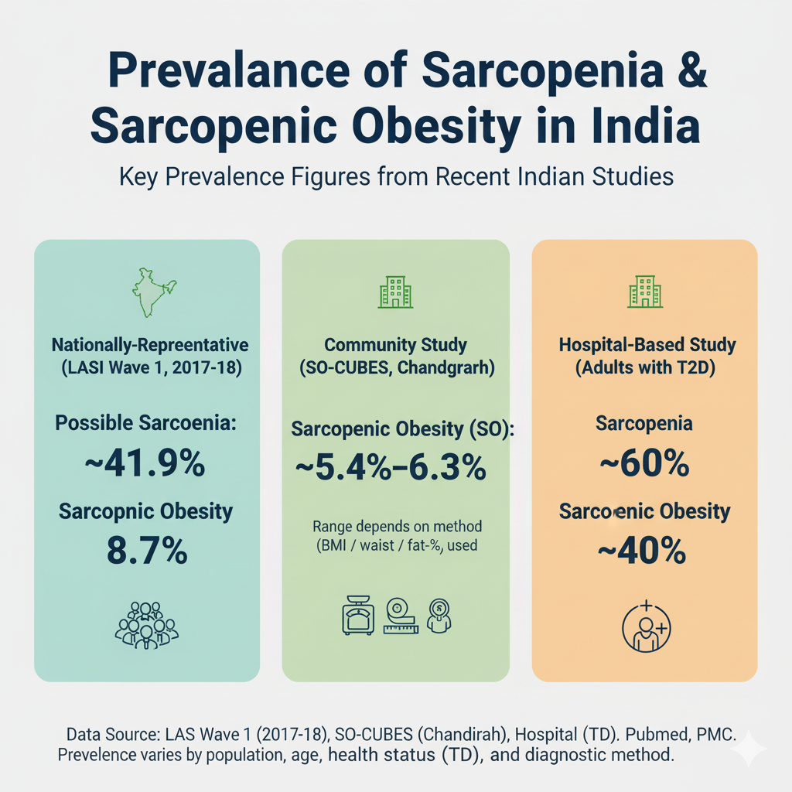

Prevalence
Meta-analysis (20 studies): Overall prevalence in T2D ≈ 27%.
Higher in North America (~30%), variable by assessment method (e.g., BIA: 24%).
Elderly diabetics (≥65 years): 13–14% prevalence with poorer function in men.
Some studies show rates up to 40% in diabetic populations.
Community older adults (≥65 yrs): SO ≈ 5.4%–6.3%.
National survey (45 yrs+): possible sarcopenia ≈ 41.9%; SO ≈ 8.7%.
Adults with T2D: sarcopenia ≈ 60%; SO ≈ 40%.
Sarcopenic obesity affects 13–40% of people with diabetes, highlighting the need for screening.

Slide 4
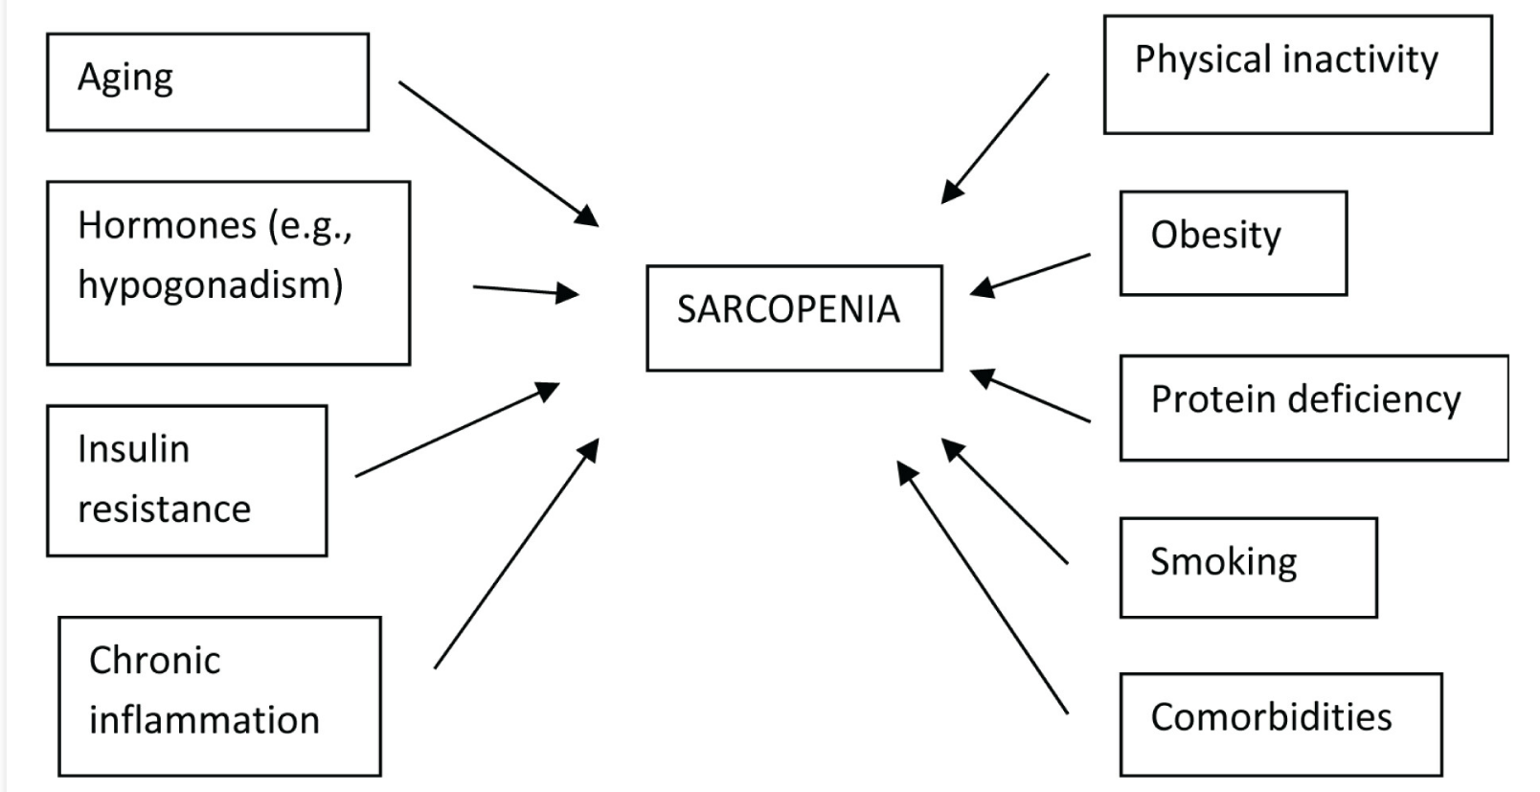
Sarcopenia In T2DM
Another study - Reported prevalence: 15–44% in diabetics.
Risk factors: inactivity, inflammation, poor glycemic control, mitochondrial dysfunction.
Sarcopenia linked with higher mortality and reduced quality of life.
The treatment focusses on dietary protein intake (1.2-1.6 g/kg/day), vitamin D supplements, resistance and aerobic exercise, weight management (careful calorie restriction to avoid muscle loss), and blood glucose control.
Sarcopenia negatively impacts T2DM outcomes, including quality of life and mortality. Early detection and combined lifestyle and pharmacological therapies are critical for controlling sarcopenia in diabetes individuals.

Slide 5
02
Pathophysiology
The Vicious Cycle
Notes:
Sarcopenia and obesity frequently coexist in Type 2 Diabetes (T2D).
Body composition analysis (BCA) enables early detection of muscle–fat imbalance.
Understanding these interactions helps improve diabetic management and outcomes.

Slide 6
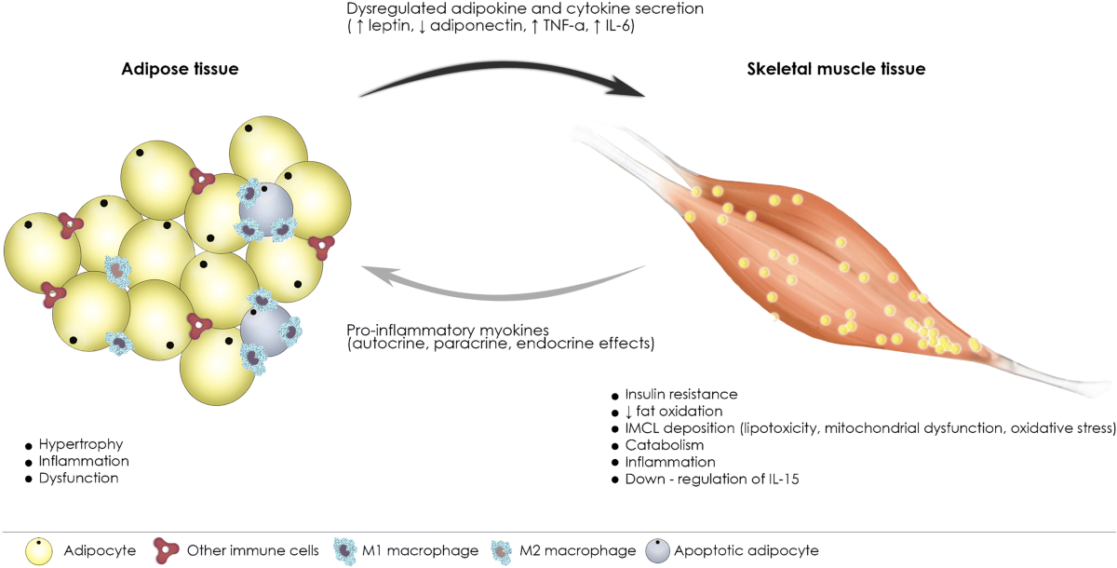
Pathophysiology – The vicious cycle
Sequence of events:
Excess adipose tissue → inflammatory cytokines (TNF-α, IL-6).
Inflammation → muscle protein breakdown and suppressed synthesis.
Muscle loss → insulin resistance and reduced glucose disposal.
Insulin resistance → further fat accumulation and mitochondrial dysfunction.
Cycle perpetuates with aging, hormonal decline, and inactivity.

Slide 7
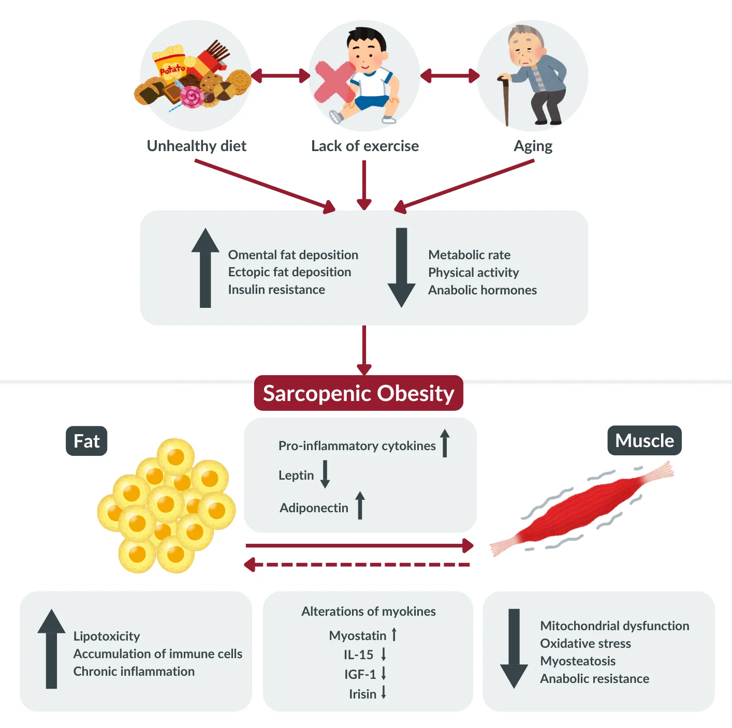
Pathophysiology – The vicious cycle
Physical inactivity and poor nutrition worsen anabolic resistance, amplifying muscle mass decline and fat accumulation, creating a vicious cycle of sarcopenic obesity

Slide 8

Complications
Reduced muscle strength and endurance causing difficulty in daily activities, slow walking speed, balance issues, and increased risk of falls and fractures.
Excess fat leads to obesity-related symptoms like joint pain, limited physical function, fatigue, and respiratory difficulties.
Increased risk of metabolic complications such as type 2 diabetes, dyslipidemia, hypertension, and insulin resistance due to combined muscle loss and fat gain.
Higher likelihood of cardiovascular diseases including hypertension, atherosclerosis, heart failure, and increased all-cause mortality.
Cognitive impairments and neurodegenerative risks caused by muscle loss reducing protective myokines and fat-induced inflammation leading to oxidative stress in the brain.

Slide 9
03
Diagnostic Criteria and Staging
Notes:
Sarcopenia and obesity frequently coexist in Type 2 Diabetes (T2D).
Body composition analysis (BCA) enables early detection of muscle–fat imbalance.
Understanding these interactions helps improve diabetic management and outcomes.

Slide 10
Diagnostic Criteria
Muscle mass
Obesity
Muscle strength & Function
BMI ≥ 30 kg/m² or high % body fat.
Visceral fat via waist circumference, BIA (>100cm2) or CT/MRI.
Measured by DXA or BIA.
Low ASMI: < 7.0 kg/m² (men), < 5.7 kg/m² (women).
Handgrip < 27 kg (men), < 16 kg (women).
Gait speed < 0.8 m/s or
poor chair stand = functional impairment.

Slide 11
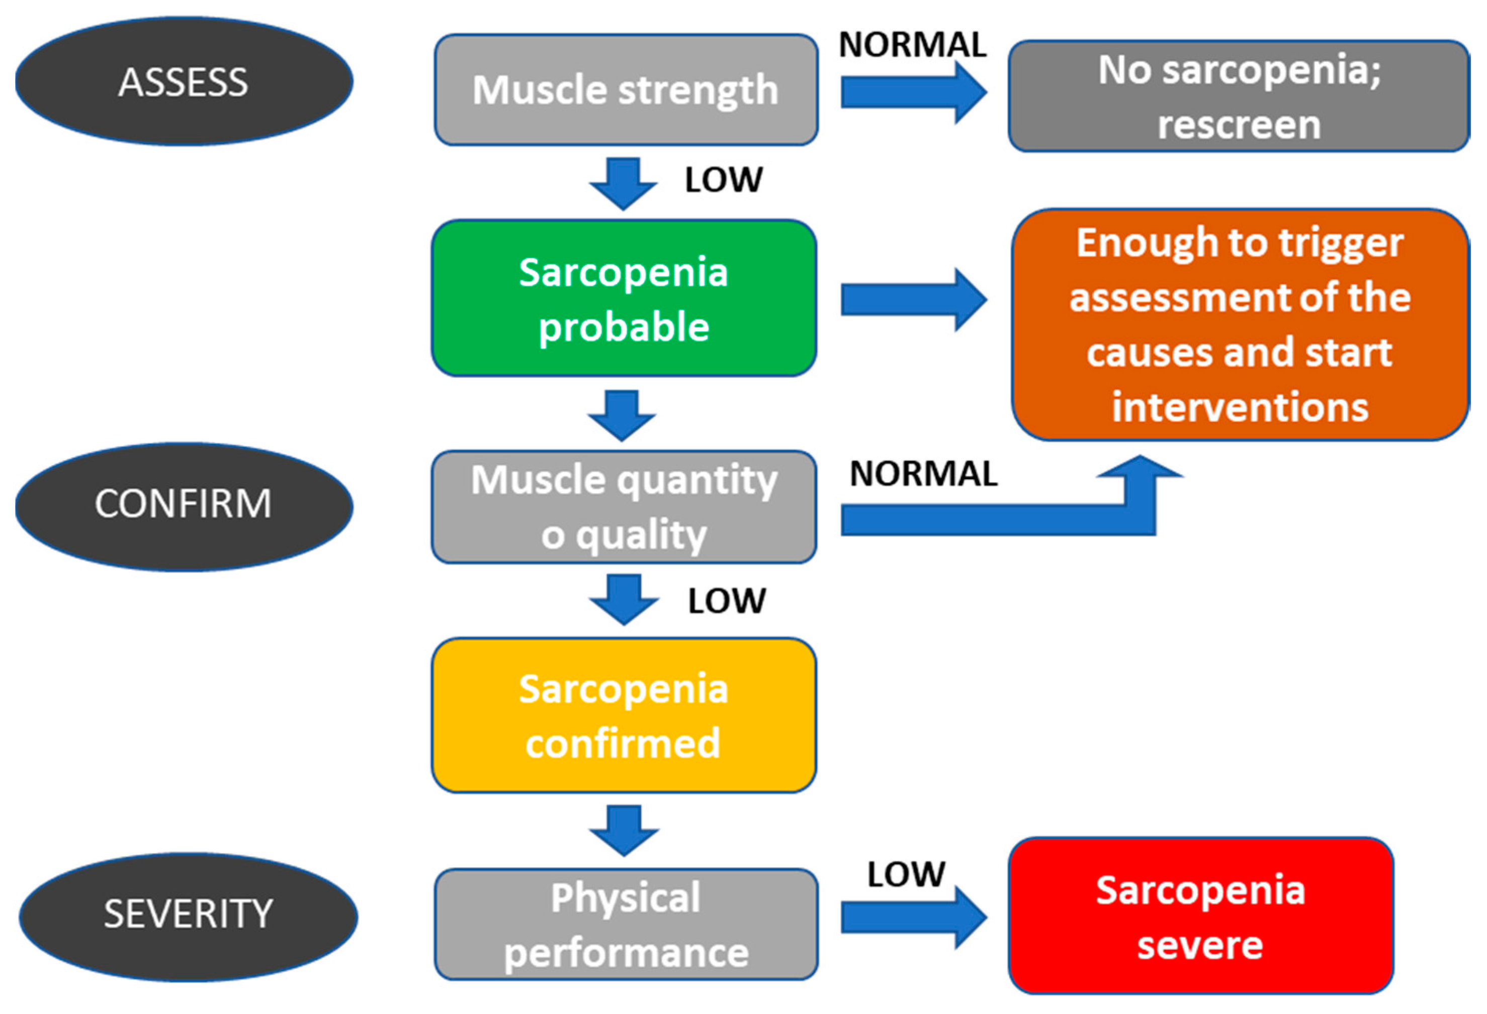
Diagnostic Criteria & Staging

Slide 12
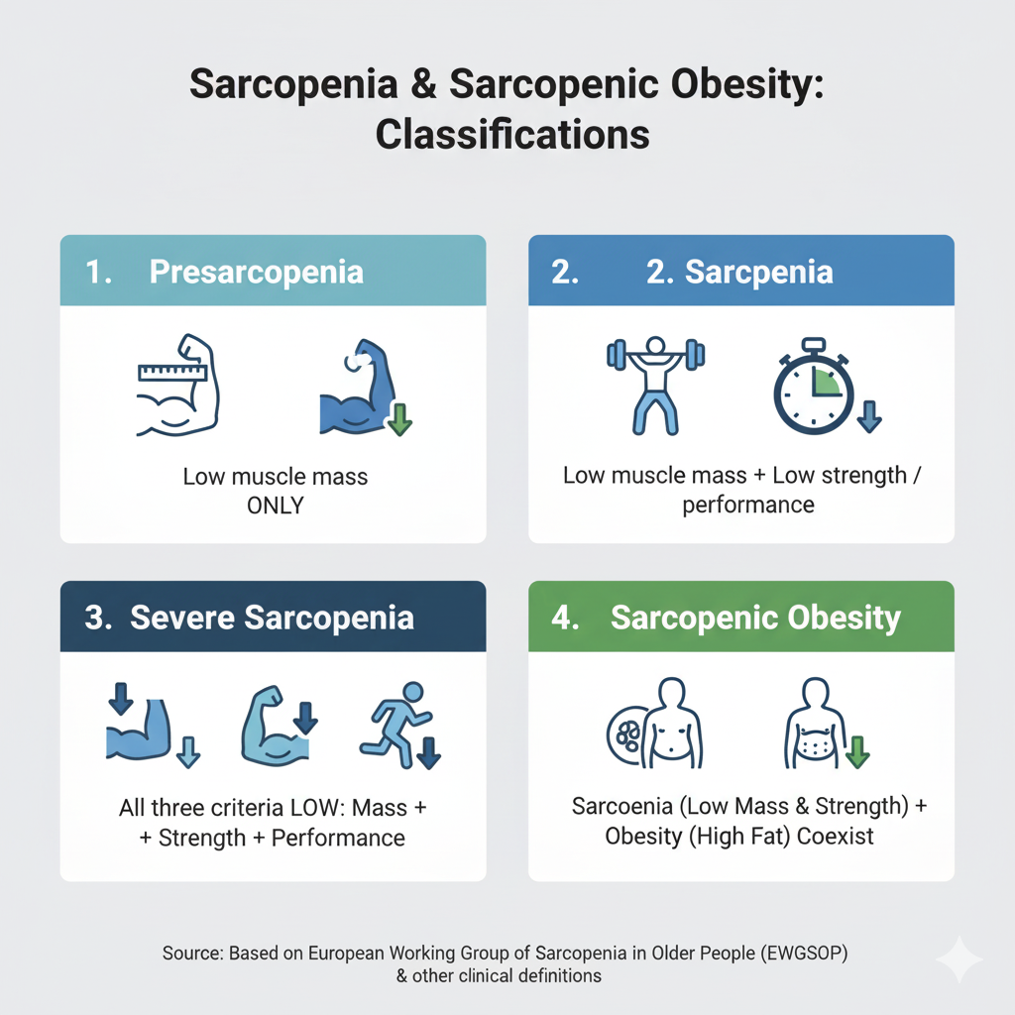
Diagnostic Criteria & Staging
Staging
Presarcopenia: Low muscle mass only.
Sarcopenia: Low mass + low strength/performance.
Severe Sarcopenia: All three criteria low.
Sarcopenic Obesity: Sarcopenia + obesity coexist.

Slide 13
04
InBody Applications in Sarcopenic Obesity
Notes:
Sarcopenia and obesity frequently coexist in Type 2 Diabetes (T2D).
Body composition analysis (BCA) enables early detection of muscle–fat imbalance.
Understanding these interactions helps improve diabetic management and outcomes.

Slide 14
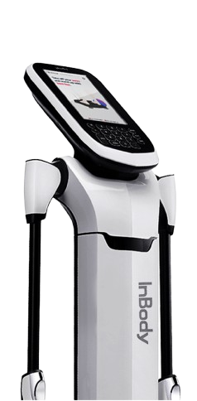
InBody Applications in Sarcopenic Obesity
Muscle - Fat Analysis
Fat Analysis
Skeletal Muscle Index
Hand Grip Strength
Notes:
InBody allows us to go beyond appearances and numbers on a scale.
It detecs: Muscle analysis, fat analysis, SMI, Handgrip strength.

Slide 15
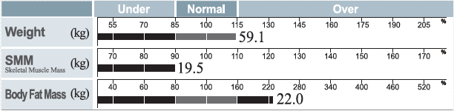
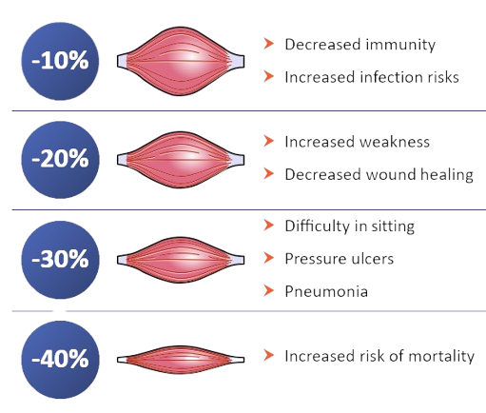
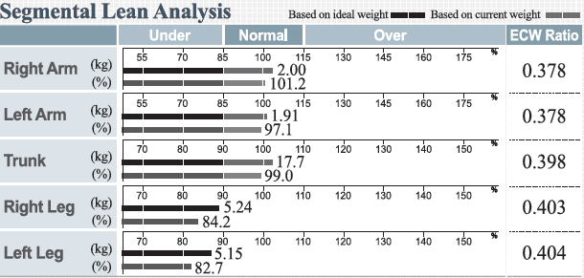
Low Muscle mass
High Body fat mass
Detects Localized Muscle Loss
Identifies Imbalances
1. Stephen WC & Janssen I. J Nutr Health Aging May 2009;13(5):460e6 2. Villareal DT, et al. Obes Res Jun 2004;12(6):913e2 3. Kyle UG et al. Clin Nutr Feb 2005;24(1):133e42.
Notes:
As studies showed the gradual degradation of Muscle mass can lead to mortality, maa’am this parameters will help u asses the skeletal muscle mass and segmental lean analysis.

Slide 16
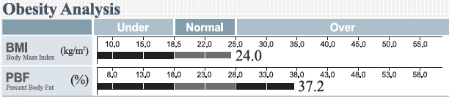
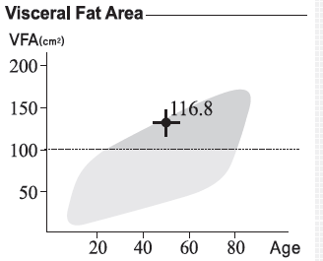
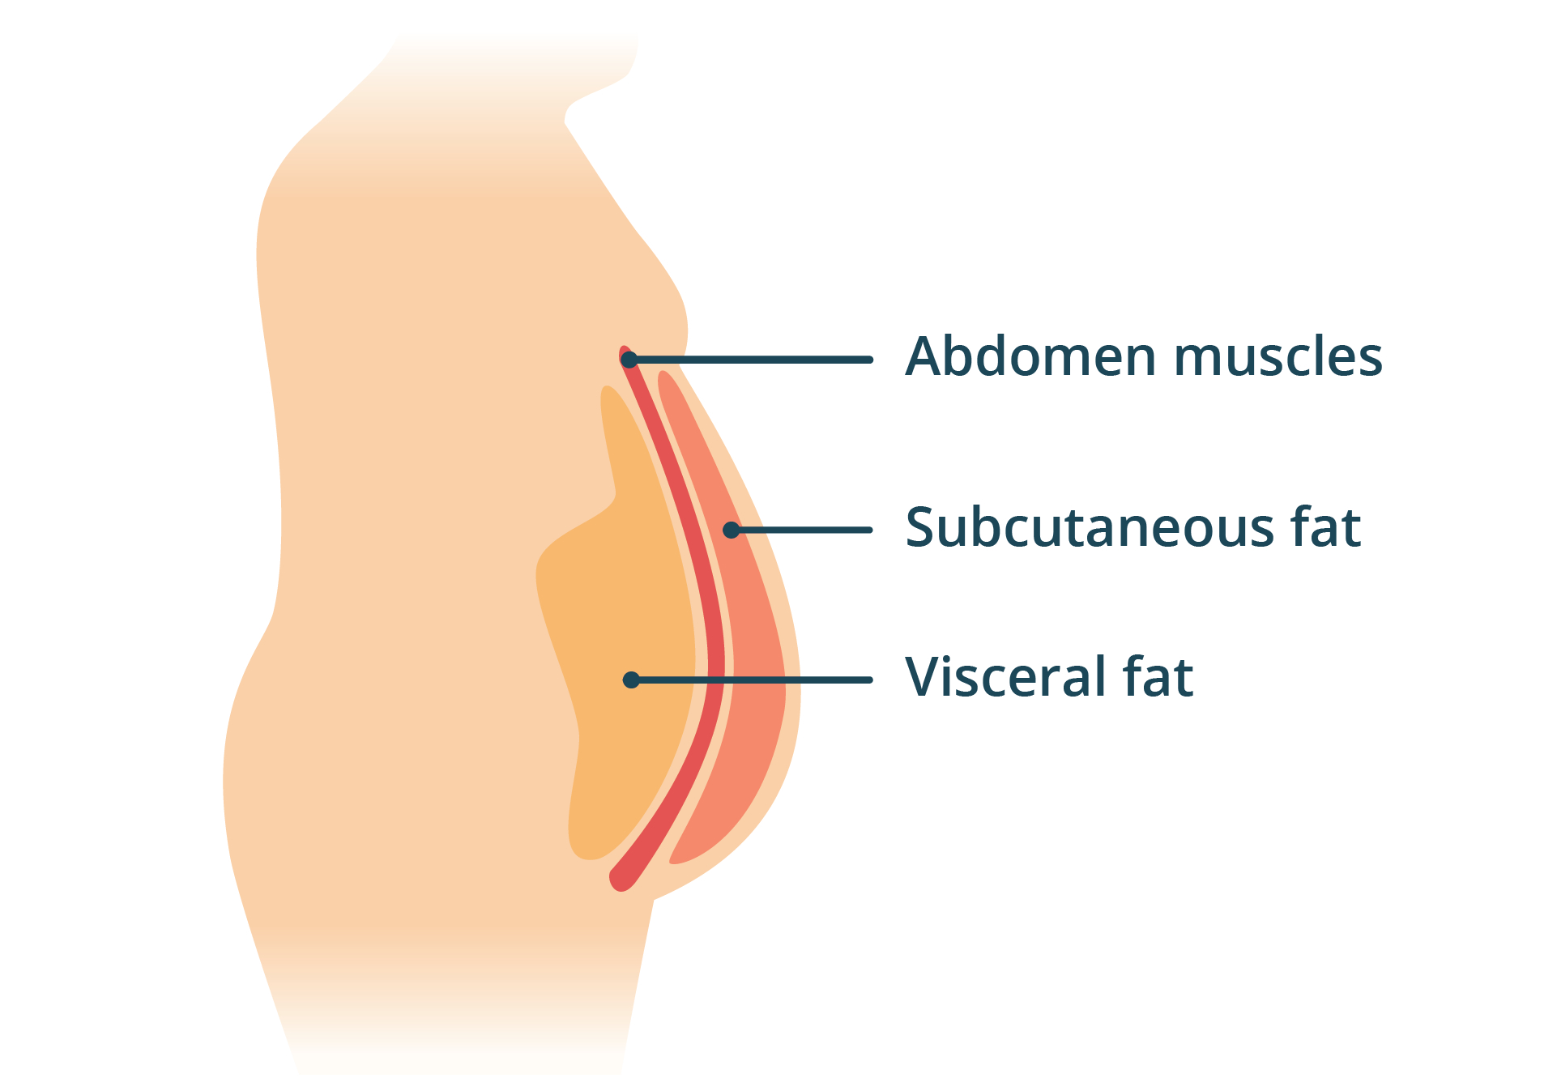
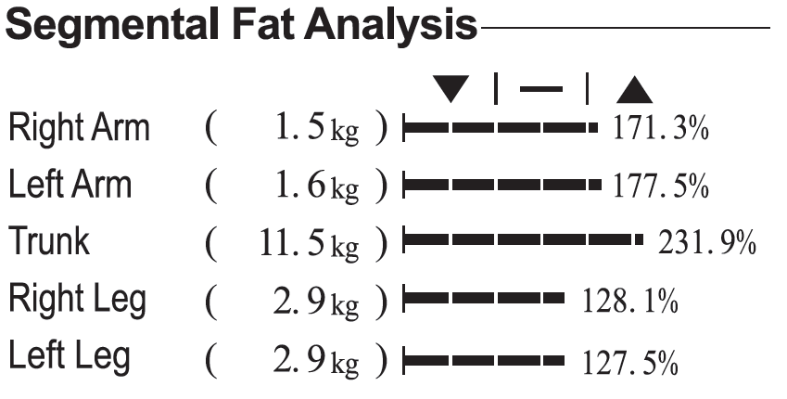
High PBF with low muscle = sarcopenic obesity
Not visible on BMI
Often hidden in clients with normal BMI or “skinny fat” body types

Slide 17
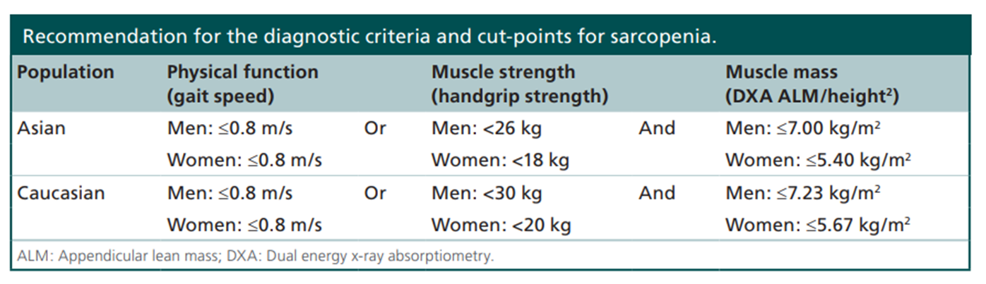
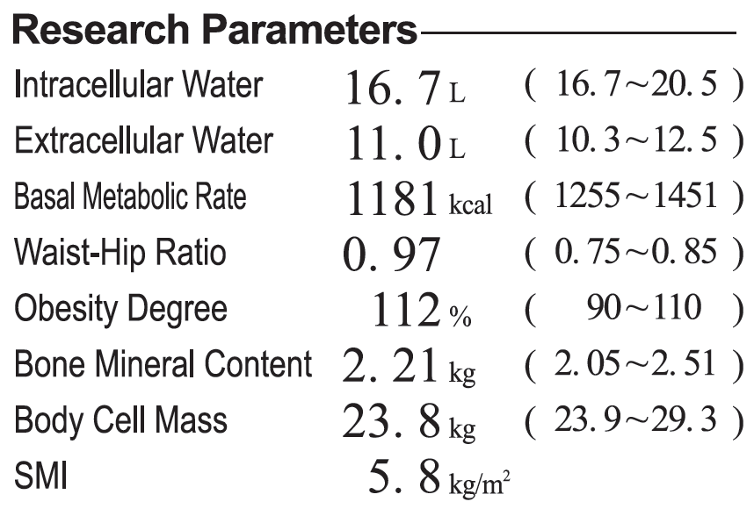
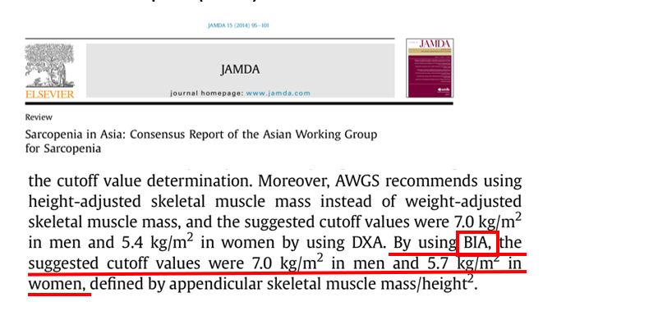
SMI (Skeletal Muscle Mass Index) is a key parameter used in diagnosing sarcopenia and sarcopenic obesity.
Notes:
. It helps us quantify muscle mass relative to height — a more meaningful indicator than BMI.

Slide 18

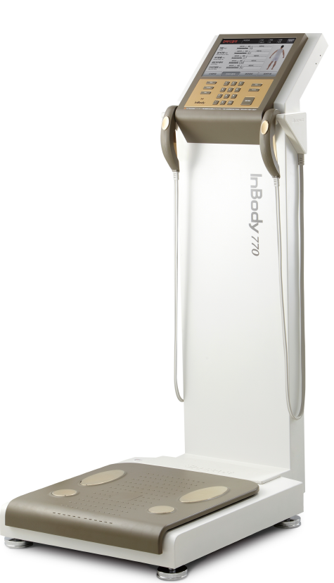
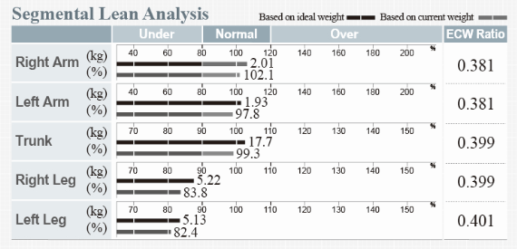
Muscle Mass and Diabetes
Body Composition |  | Symptoms | Parameter provided by InBody | Application
Screening | Risk of Diabetes | Low Muscle | SMM (Skeletal Muscle Mass) | Insulin resistance(sensitivity) related to low muscle mass
Monitoring | Muscle Wasting Disease | Muscle Decrease | SMI (Skeletal Muscle Index) | Sarcopenia Evaluation
Measurement
SMI = Appendicular Lean(RA + LA + RL + LL) / Height²
Notes:
그렇기 떄문에 우리는 근육량을 통해 당뇨의 위험을 Screening하고,
당뇨인 환자들의 근육량이 줄어들지 않도록, 저근육증이 오지 않도록 인바디를 통해 관리해야한다고 말할 수 있는 것이다.

Slide 19
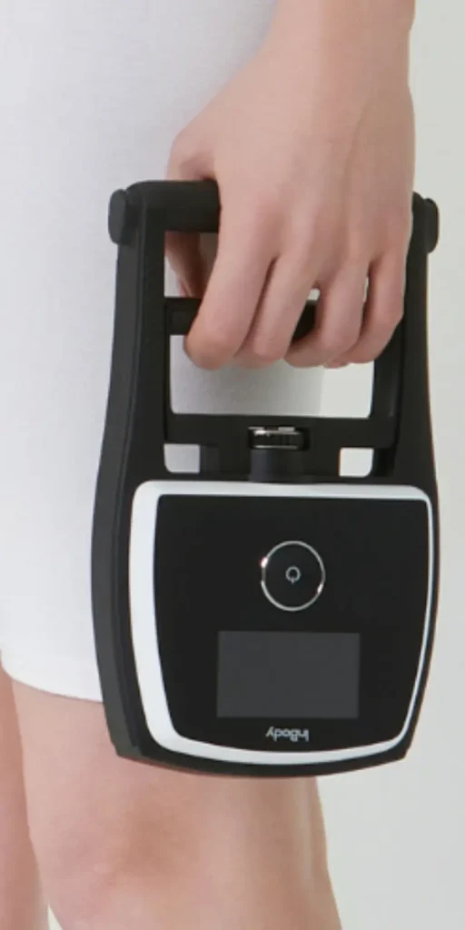

Hand Grip Strength
A key indicator of overall muscle strength.
Low grip strength = low muscle function, even if body weight seems fine
It’s a diagnostic criterion for sarcopenia
Strong predictor of frailty, falls, and disability
Cut-offs:
Men: <28 kg
Women: <18 kg

Slide 20
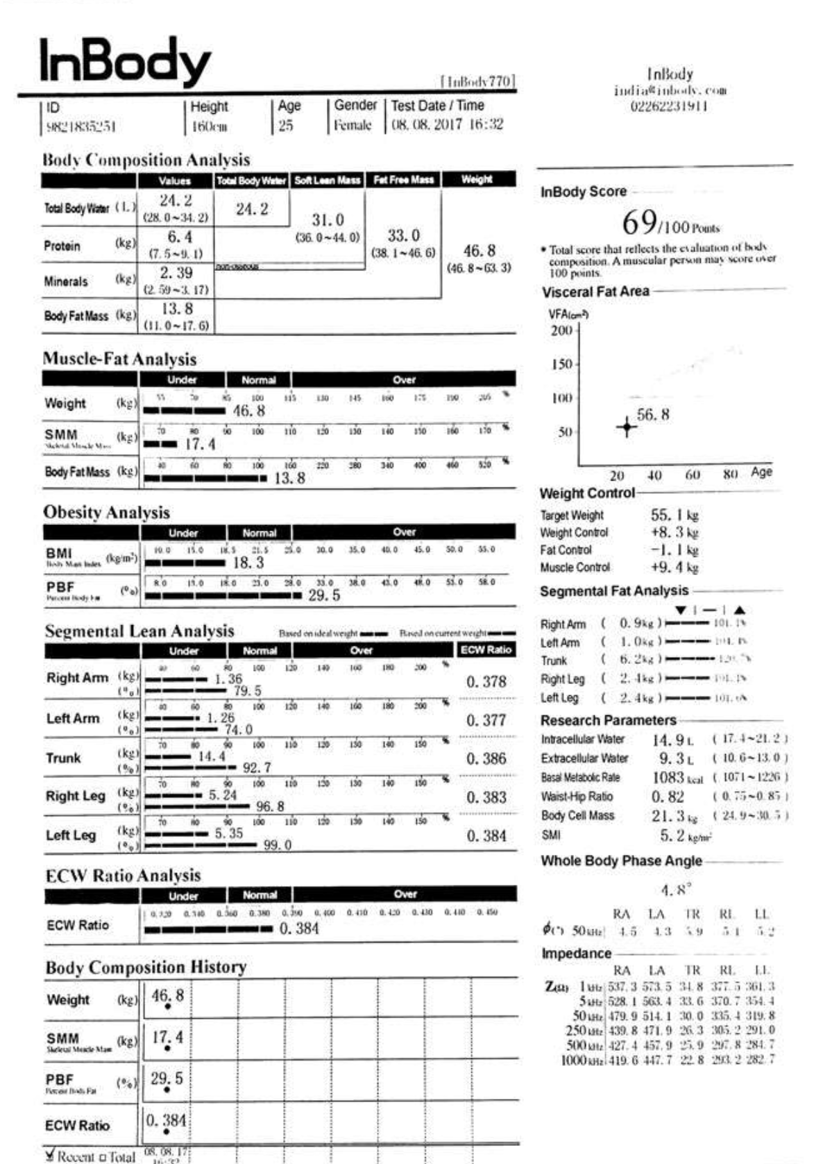
CASE STUDY : 01
Case 1 : 25 yo, F , unable to gain weight
The patient had visited the clinic complaining that she is unable to gain weight even on continuous good diets.
Upon BCA examination , we found that the protein levels were indicating Under at 6.4kg.
The SMM was also severely under and the PBF has just crossed the border at 29.5% .(Ideal Range 18-28%)
While the VFA is low the increased sub-cutaneous fat levels are concerning.
The SMI is at 5.2 kg/m² indicating the presence of Sarcopenia .

Slide 21
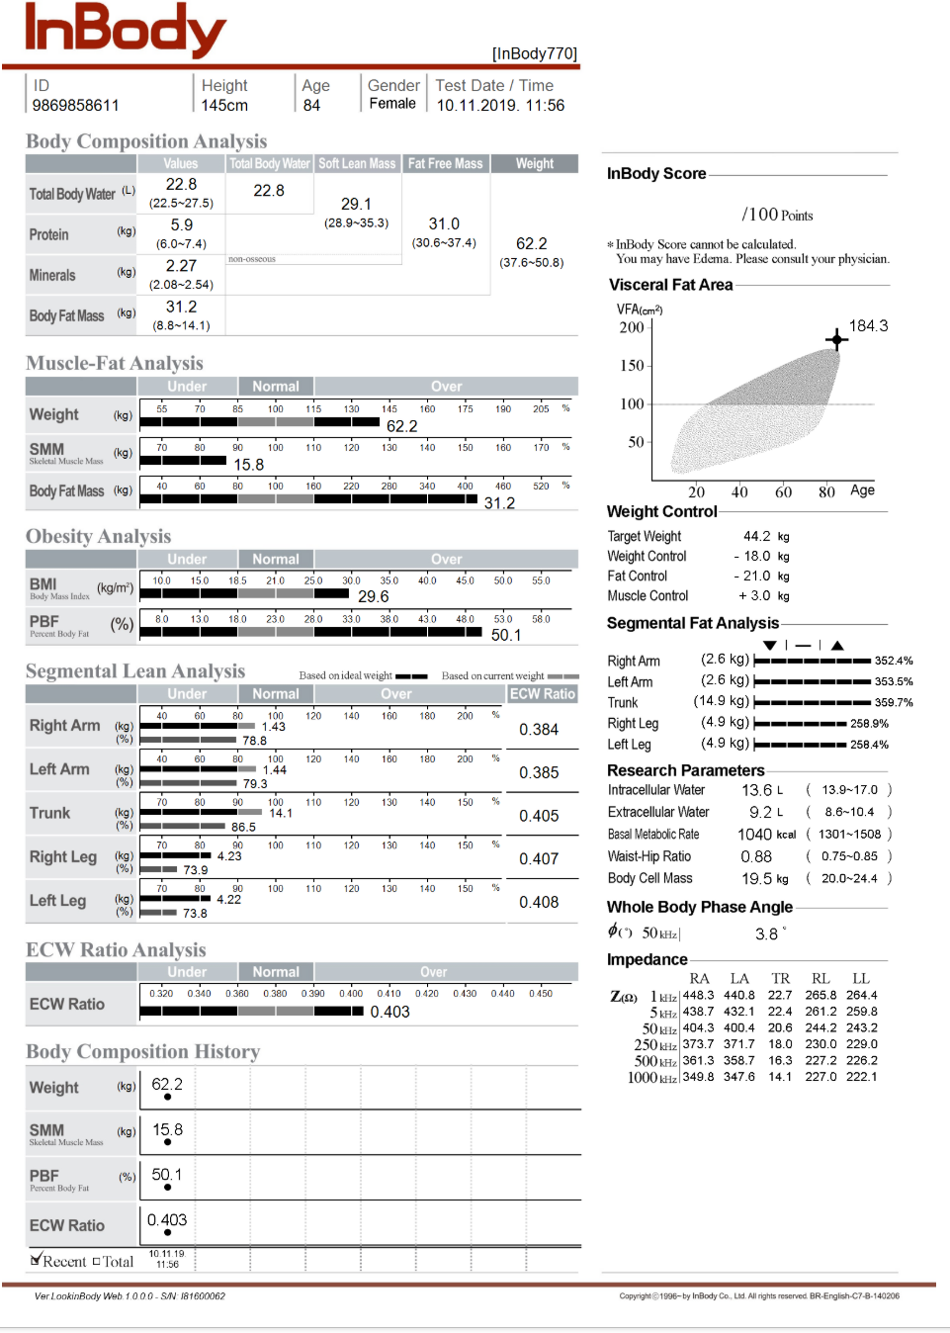
CASE STUDY : 02
Case 2 : F , 84Yo Age related muscle loss
84 year old female was examined BCA on routine exam. She had difficulty in walking
Upon BCA examination , we found the age old muscle depletion had taken place and mostly the lower limbs muscle loss was prominent with ECW ratio crossing the normal ranges (0.360 – 0.390).
The PBF was at a whopping 50.1%.
Even when we see the Visceral fat levels they were through the roof at 184 kg/m² and also the Phase Angle levels were 3.6 , indicating tissue loss and cellular damage.

Slide 22

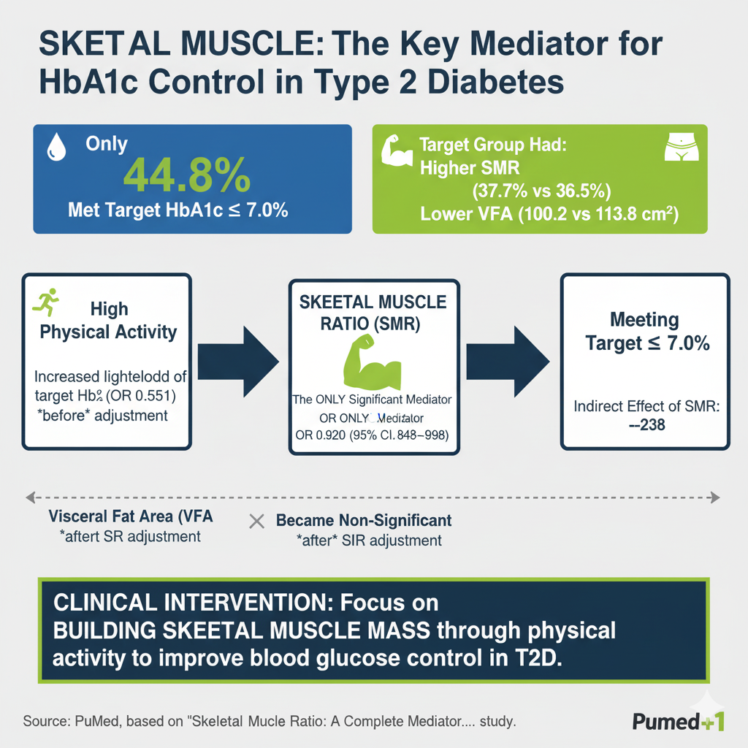
The Muscle ratio, Visceral fat and HbA1c control in T2DM
Only 44.8% of individuals met target HbA1c ≤ 7.0%.
Higher skeletal muscle ratio (SMR) in target-group: 37.7% vs 36.5%.
Lower visceral fat area (VFA) in target-group: 100.2 vs 113.8 cm².
High physical activity increased likelihood of meeting HbA1c target (OR 0.551 before body composition adjustment).
After adjusting for SMR and VFA: only SMR remained significant mediator (OR 0.920, 95% CI 0.848-0.998). Indirect effect of SMR = -0.238 (95% CI -0.525 to -0.020).

Slide 23

Early Detection of Sarcopenic Obesity via BIA in Healthy Adults
184 healthy participants aged 21-70 yrs were measured for SMM, % body fat, VFA, phase angle, extracellular water.
Findings: Females had higher body fat (41 %), VFA (134.8 cm²) and lower SMM (19.4 kg) than males. Mean BMI nearly equal (26.5 vs 25.5).
High correlation between BMI and % body fat (~0.8) but only moderate link with SMM (~0.45).
Conclusion: BIA is effective for detecting and monitoring sarcopenic obesity; BMI alone may mislead.

Slide 24
05
Clinical Implication in Diabetes Care
Notes:
Sarcopenia and obesity frequently coexist in Type 2 Diabetes (T2D).
Body composition analysis (BCA) enables early detection of muscle–fat imbalance.
Understanding these interactions helps improve diabetic management and outcomes.

Slide 25
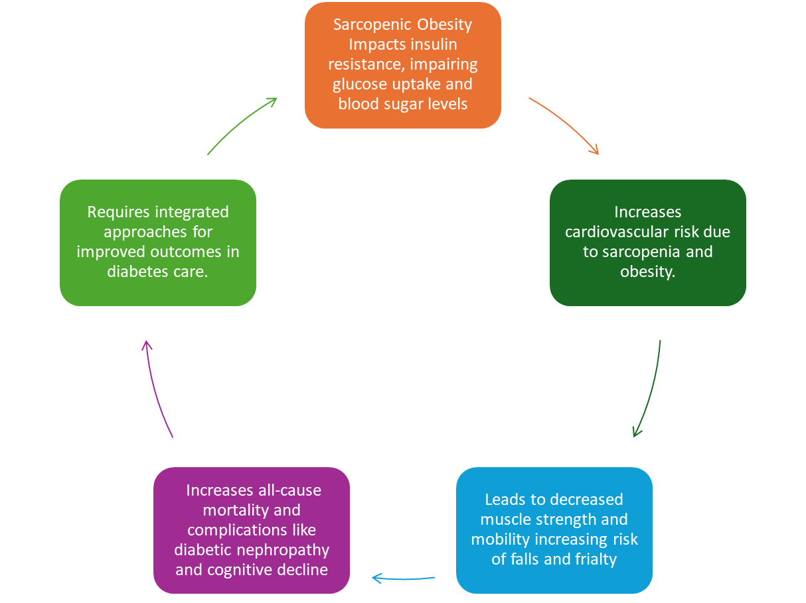

Clinical implication in Diabetes Care
Sarcopenic obesity worsens insulin resistance, glycemic control, and mobility.
Routine BCA-based screening helps tailor exercise and nutrition plans.
Integrated approach: endocrinologist + dietitian + physiotherapist for muscle preservation.

Slide 26
06
Management –
Tri- faced approach
Notes:
Sarcopenia and obesity frequently coexist in Type 2 Diabetes (T2D).
Body composition analysis (BCA) enables early detection of muscle–fat imbalance.
Understanding these interactions helps improve diabetic management and outcomes.

Slide 27
Management- Tri- faced Approach
1. Lifestyle
Resistance and aerobic training
Protein intake 1.2–1.6 g/kg/day
Vitamin D supplementation
2. Pharmacological Options
Optimize diabetes medications (minimize lean mass loss)
Emerging: Myostatin inhibitors, SARMs, anti-inflammatory drugs
3. Regular Monitoring
BIA/DXA for body composition
Functional tests: handgrip strength, gait speed
Lifestyle Interventions
for Muscle Health
Exercise & Nutrition
Pharmacological Options & Emerging Therapies
New therapies include myostatin inhibitors, SARMs, and anti-inflammatory agents.
Regular Body Composition Monitoring
complementary handgrip strength and gait speed tests

Slide 28

Summary & Take Home Message
Routine screening for sarcopenic obesity in T2D is essential.
Focus on muscle gain and fat reduction simultaneously.
Combine resistance training + high-quality protein + caloric moderation.
Monitor Phase Angle, SMI, VFA, and ECW Ratio for early intervention.
Use BCA as a precision tool for diabetes management and prognosis.

Slide 29
Thank You

